Slide 1
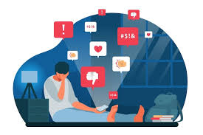
RESPONSIBLE ONLINE BEHAVIOR

Slide 2

Responsible online behavior refers to the actions and decisions we make when interacting in digital spaces. It is about acting ethically, maintaining privacy, and protecting your digital footprint while being mindful of how your actions can impact others.

Slide 3

Maintain Privacy and Security:
Protect Your Personal Information: Be cautious when sharing sensitive data online, such as passwords, personal identification numbers (PINs), addresses, phone numbers, or financial details. Use strong, unique passwords and consider two-factor authentication (2FA) for added security.
Limit Personal Disclosure: Avoid sharing intimate or personal details that could be misused. Even in trusted spaces, remember that once shared, information can be difficult to fully retract.

Slide 4

Verify Before Sharing Information:
Fact-Checking: Always verify the information before sharing it. Avoid spreading misinformation or rumors. Fake news and misinformation can harm reputations, fuel conflict, or even cause real-world consequences.
Cite Your Sources: If you share a piece of information that is not your own, ensure that you credit the original source, whether it's an article, image, or video. Plagiarism is unacceptable online.

Slide 5
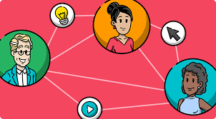
Engage in Positive Communication:
Support and Encourage: Use online platforms to encourage others, support causes, and share knowledge. Avoid negative, inflammatory comments, or unnecessary arguments.
Constructive Criticism: When offering feedback, especially in a public forum or social media, do so constructively. Provide suggestions for improvement and offer encouragement rather than criticism for the sake of it.

Slide 6

Avoid Spam and Unsolicited Messages:
Sending unwanted, unsolicited messages to others is a form of spam. Whether it’s emails, social media posts, or text messages, it’s crucial to respect others' inboxes and time.
If you are involved in marketing or promotional activities, always provide a clear way for people to unsubscribe or opt out.

Slide 7

Respect Intellectual Property:
Never steal content from other creators. Whether it’s text, images, music, or videos, always ask for permission to use someone else’s work and give them appropriate credit.
Understand copyright laws and respect the intellectual property of creators online.

Slide 8

Stay Calm and Respectful in Disagreements
Disagreements are natural, but how you manage them online can impact your reputation and the well-being of others. Avoid hostile or aggressive comments
If you disagree with someone’s opinion, express your viewpoint respectfully, using reason and not aggression. Understand that it's okay to have different opinions and that online discussions should remain civil.

Slide 9
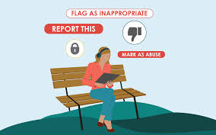
Report Abusive Behavior:
If you encounter harmful behavior online, such as cyberbullying, harassment, or offensive content, report it to the relevant platform authorities. Almost all platforms, like Facebook, Instagram, Twitter, and YouTube, offer reporting tools to flag inappropriate content.
Encourage others to speak up against harmful content or actions by creating a safe online space for all.

